Slide 1
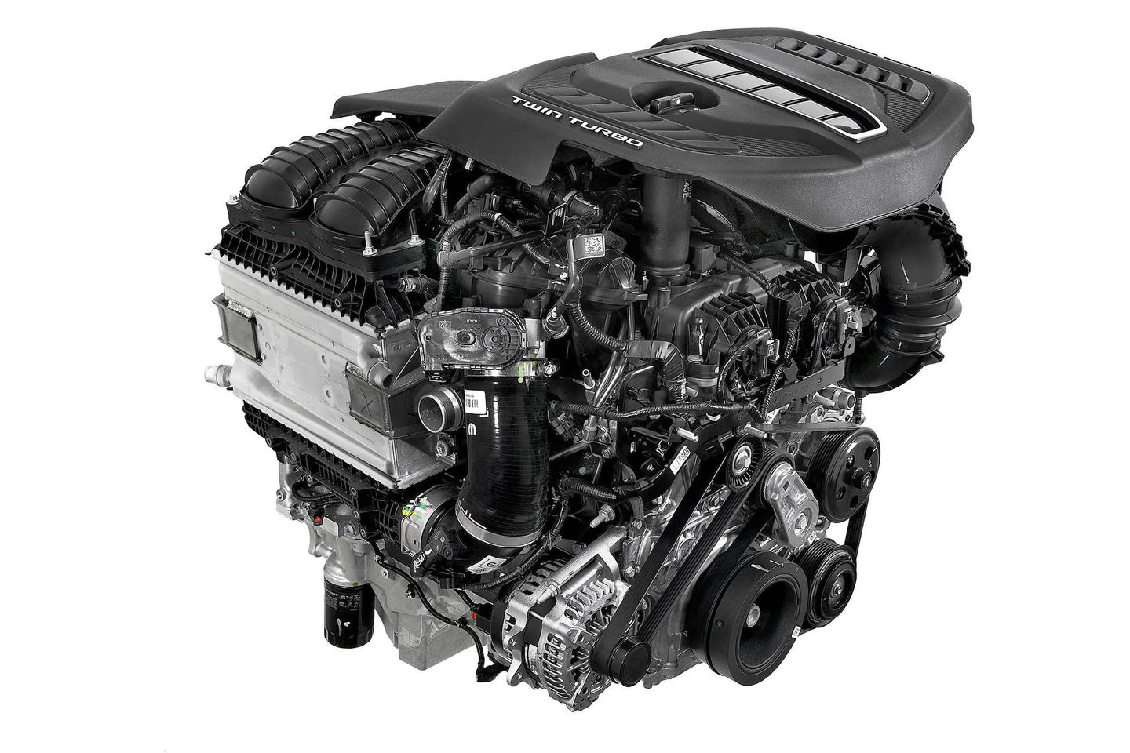

Monitoring Engine Health Through Better Fuel Consumptio
Raghav Agarwal

Slide 2

Introduction
Monitoring and analyzing vehicle data, including GPS information, engine parameters, and driving behavior, can help optimize fuel consumption. Our data aids in identifying inefficiencies, adjusting driving habits, and maintaining the vehicle within its optimal range, leading to improved fuel efficiency and cost savings.

Slide 3
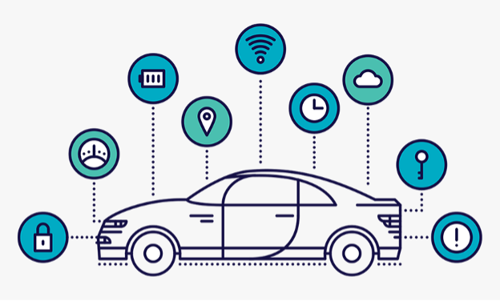
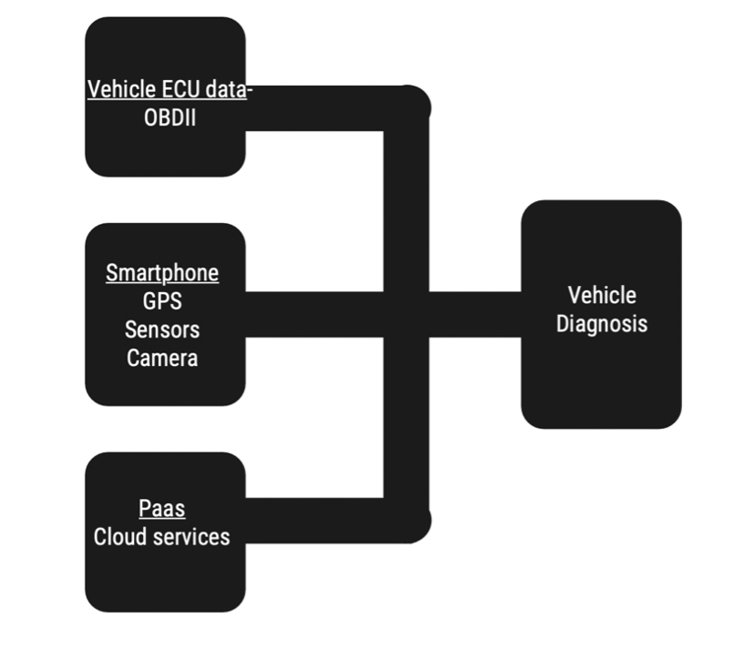
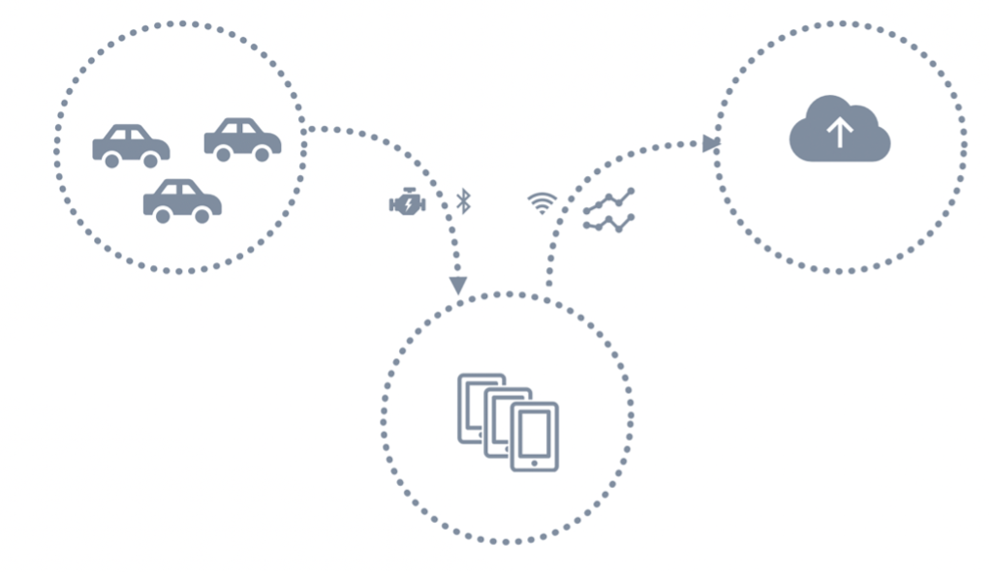
About Data
Accessing a vehicle's ECU through diagnostic protocols like OBD-II and UDS has simplified vehicle maintenance. Data from OBD-II, GPS, and timestamps can be amalgamated through third-party apps. Smartphones, with their built-in sensors like accelerometers, gyroscopes, and magnetometers, provide additional data on vehicle movement. Integrating the smartphone's camera opens applications beyond diagnostics, such as lane departure warnings and adaptive cruise control. This blend of OBD-II modules and smartphone integration is cost-effective for vehicle diagnostics and prognosis. However, it's crucial to address privacy and security concerns when handling this data, while adhering to relevant regulations.
Data Size : (2193 , 84)

Slide 4
Work Summary
1
2
Team
Check of Columns
Are columns following the analysis Expected
Solution Building
Solution using clusters
Descriptive Analysis
Creating Descriptive analysis of each column
Creation of Label Column: Fuel Mass Consumption
Creation of label column
1
Raghav
Harsha
Sanjay
Shikha
Team Segregation
2
1
Descriptive Analysis
1
2
2
Creation of Label Column: Fuel Mass Consumption
1
1
2
Solution Building
2
Check of Columns
Main Solution Implementation
1
2
1
2
Main Solution

Slide 5
1
2
Main Solution Implementation

Slide 6
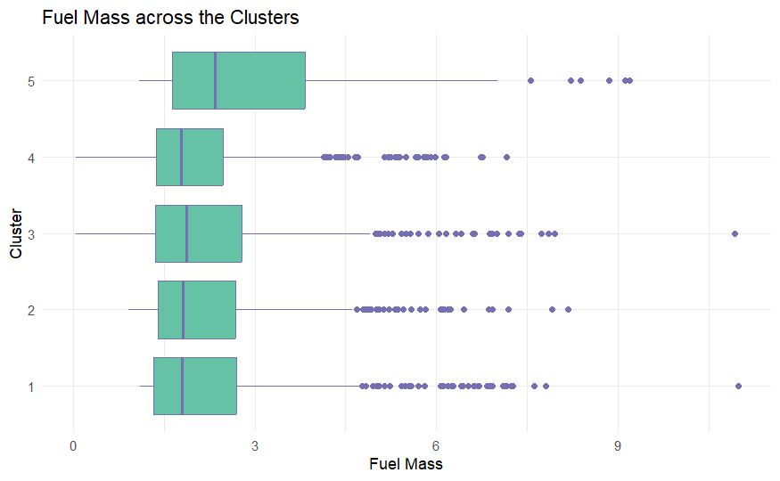





Cluster The Trips
See which Cluster has greater right shift in Fuel Mass consumption,
Follow up for the recommendation based on descriptive analysis with respect to Fuel Consumption.
Compare better parameters Confidence intervals, Either right/left shift based on the trip data available for each cluster and give out recommendation
Clusters

Slide 7
Shifts for Columns based on Trips

Slide 8
Shifts for Columns based on Throttle and Pedal

Slide 9
Shifts for Columns based on Engine Performance 1

Slide 10
Shifts for Columns based on Engine Performance 2

Slide 11
Project 2 Proposal

Slide 12
Thank You

